Slide 1

Traditional Malaysian Heritage
Congkak
The Traditional Heart of Malaysia
An introduction to Congkak — a traditional Malaysian board game of strategy and social bonding, rooted in centuries of cultural heritage and royal tradition.
2026
A Cultural Heritage Presentation

Slide 2

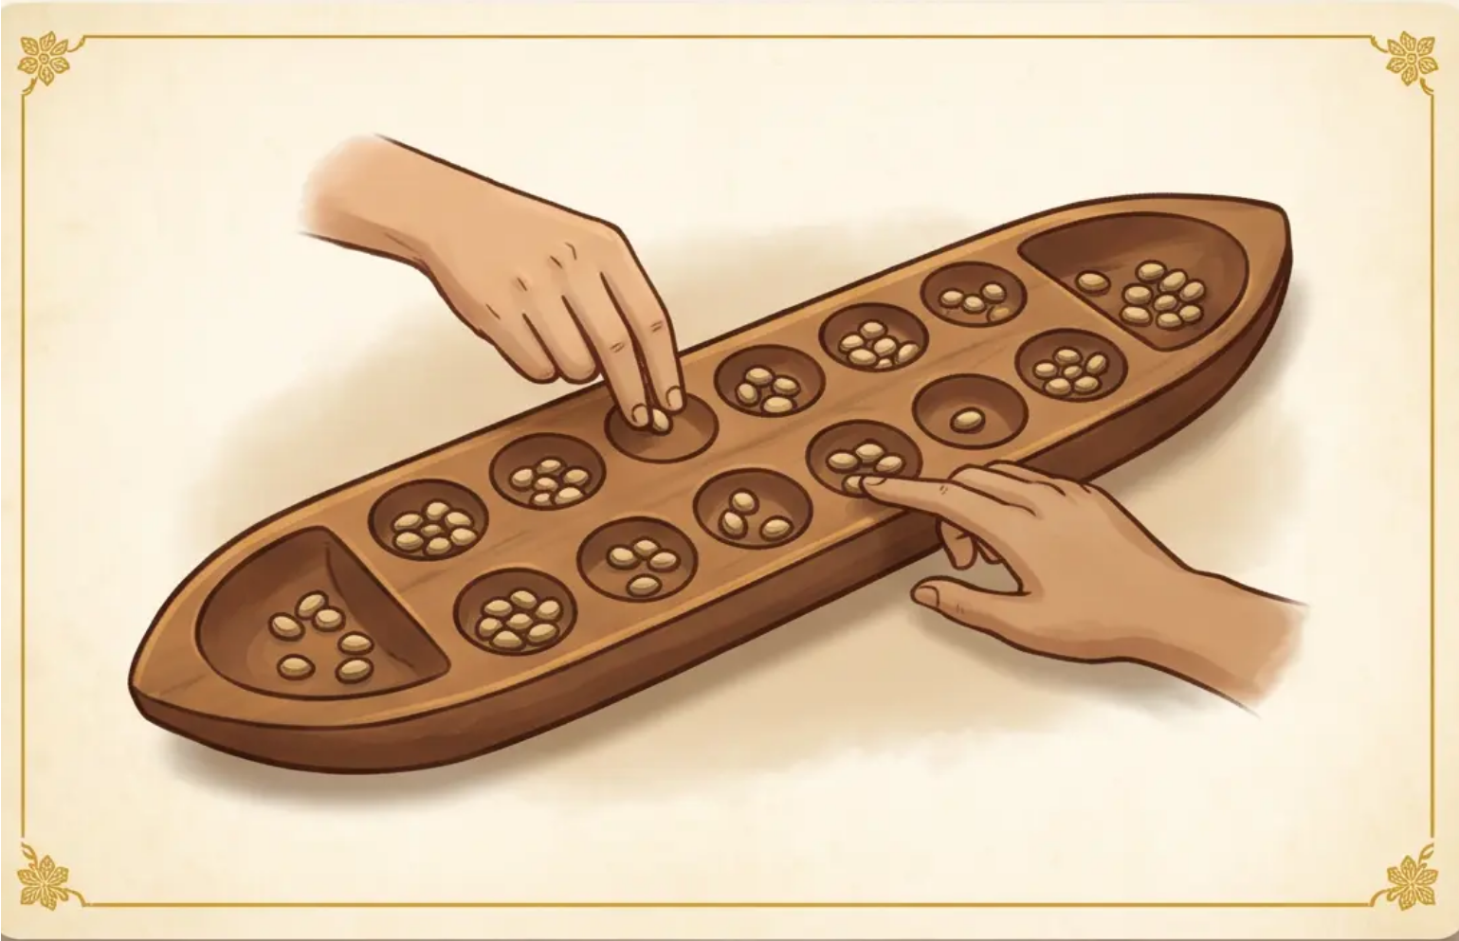





Rules & Gameplay
Summary of Rules
🎯 OBJECTIVE
Accumulate the most seeds in your Rumah — your home store at the end of the board.
📜 THE BOARD
A boat-shaped board with 14 small Kampung holes in two rows, and 2 large Rumah at each end. Each Kampung begins with 7 seeds.
“Sowing seeds clockwise — the heartbeat of Congkak”
KEY RULE
A turn ends when the last seed falls into an empty hole.
🔄 THE FLOW
Players sow seeds clockwise, dropping one seed per hole. Drop into your own Rumah — always skip the opponent's.
Land in your Rumah? Play again. Land on seeds? Keep sowing.
02
05

Slide 3


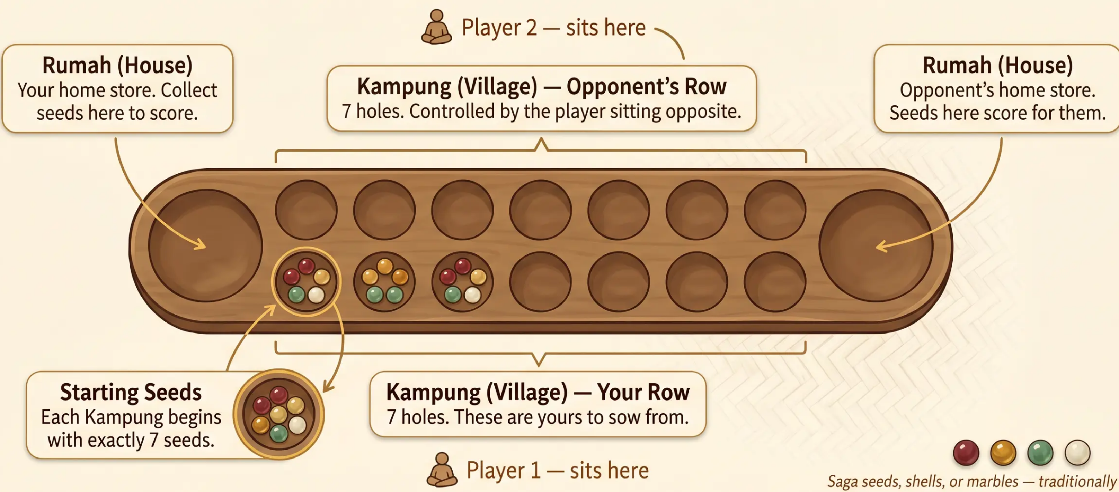
Board Components & Setup
03 / 05
♦ Setup: 14 Kampung holes × 7 seeds each = 98 seeds in play ♦ Both Rumah start empty

Slide 4

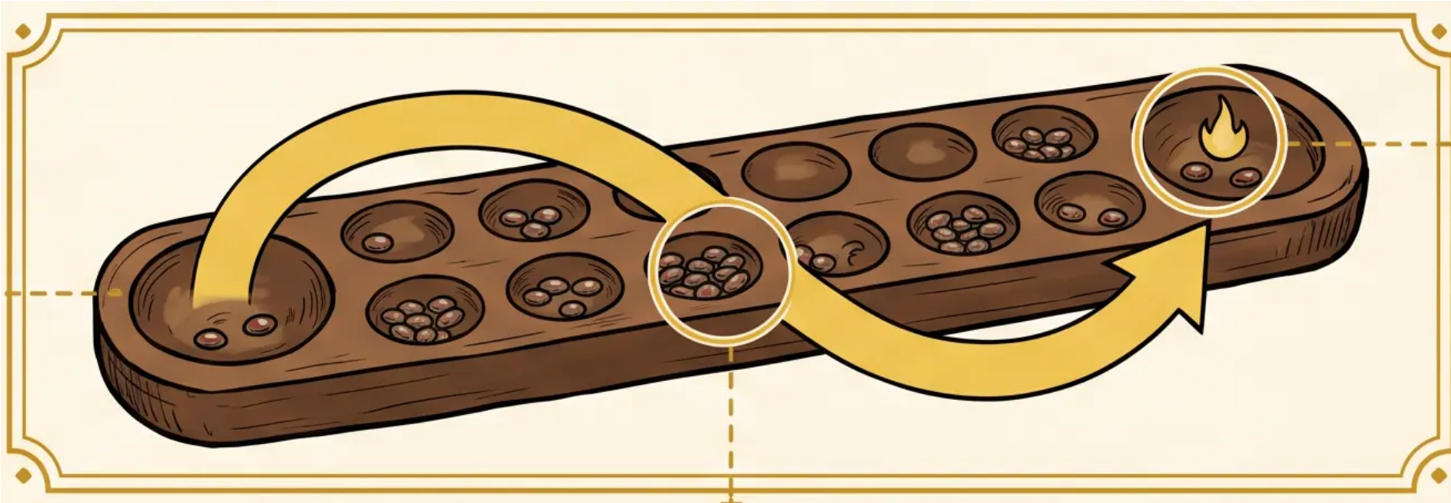

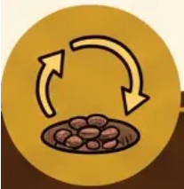


Gameplay Mechanics
The Sowing Cycle
& Extra Turns
Menyemai (Sowing)
Relay Play (Terus)
Extra Turn (Gimbahan)
The Sowing Act
Landing in an Occupied Hole
Extra Turn Reward
Pick up all seeds from any of your Kampung holes. Drop one seed into each hole clockwise — including your own Rumah, but skipping your opponent's.
When your last seed lands in a hole that already contains seeds, scoop them all up and continue sowing without stopping.
If your last seed lands exactly in your own Rumah, you earn a bonus turn. Choose any of your Kampung holes and begin sowing again.

Slide 5

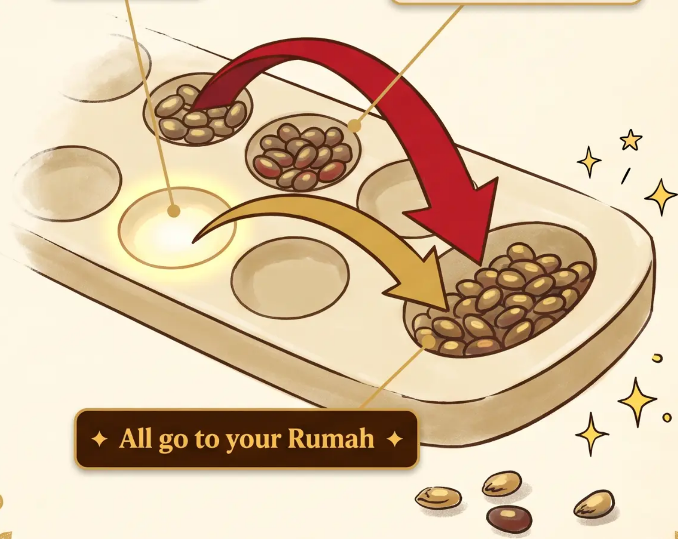


Strategic Moves
Capturing & Scoring
Last seed lands here
Opponent's seeds — captured!
The Art of Tembak
Tembak — The Capture
01
When your last seed lands in an empty hole on YOUR side, you capture all seeds from the opponent's hole directly opposite — plus your own final seed.
02
Scoring into the Rumah
All captured seeds travel to your Rumah (home store). Every seed in your Rumah at game's end counts as one point.
Winning the Game
03
The game ends when ALL Kampung holes are empty. Count the seeds in each Rumah — the player with the most seeds wins.
Most Seeds in the Rumah Wins — Count carefully, play wisely.

